Slide 1
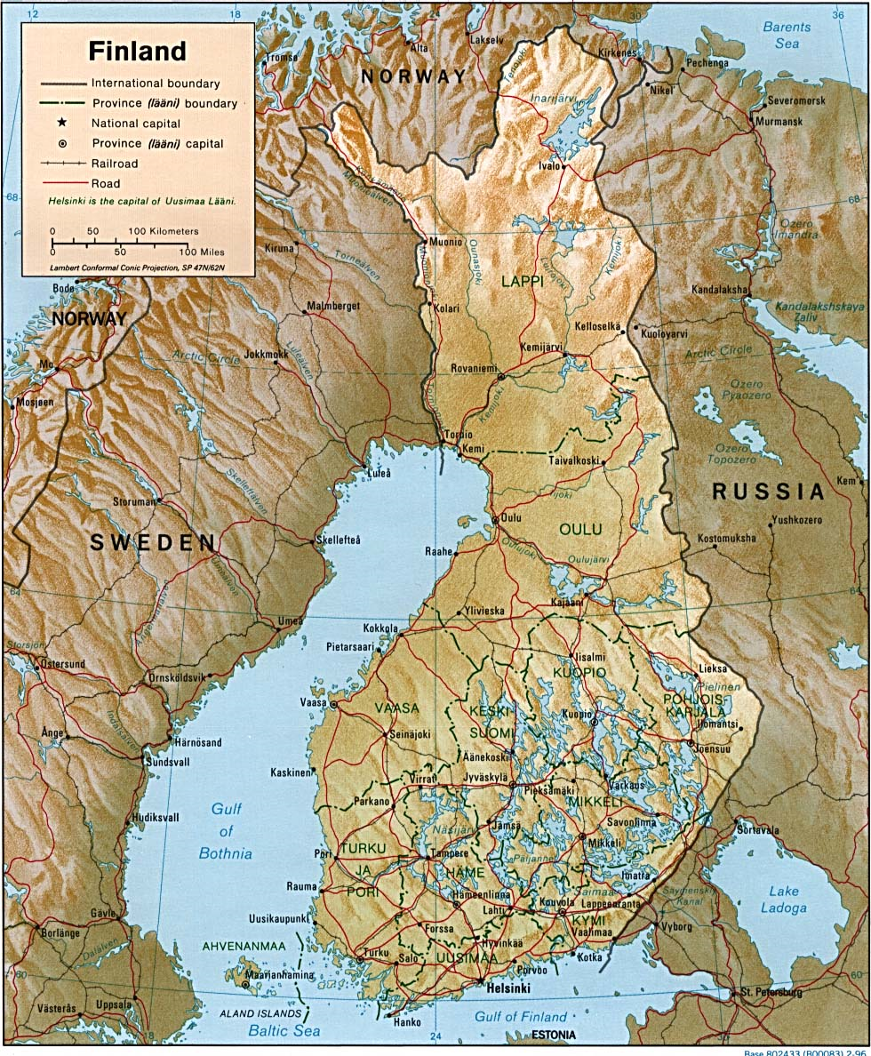

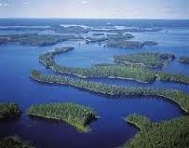
International activities in Finland 2015
Mgr. Barbora Faltová
Faculty of Health Studies
University of Pardubice
Autumn 2015

Slide 2
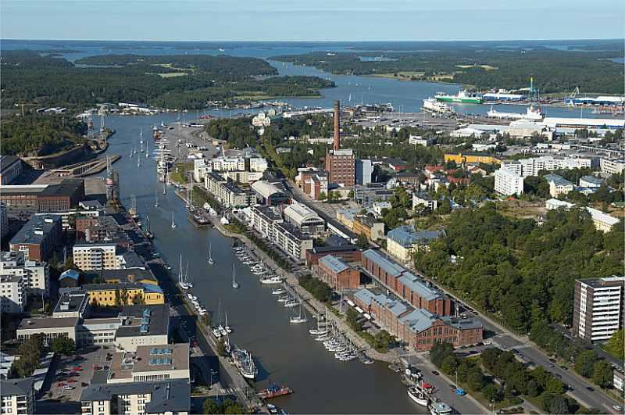
The city of Turku

Slide 3
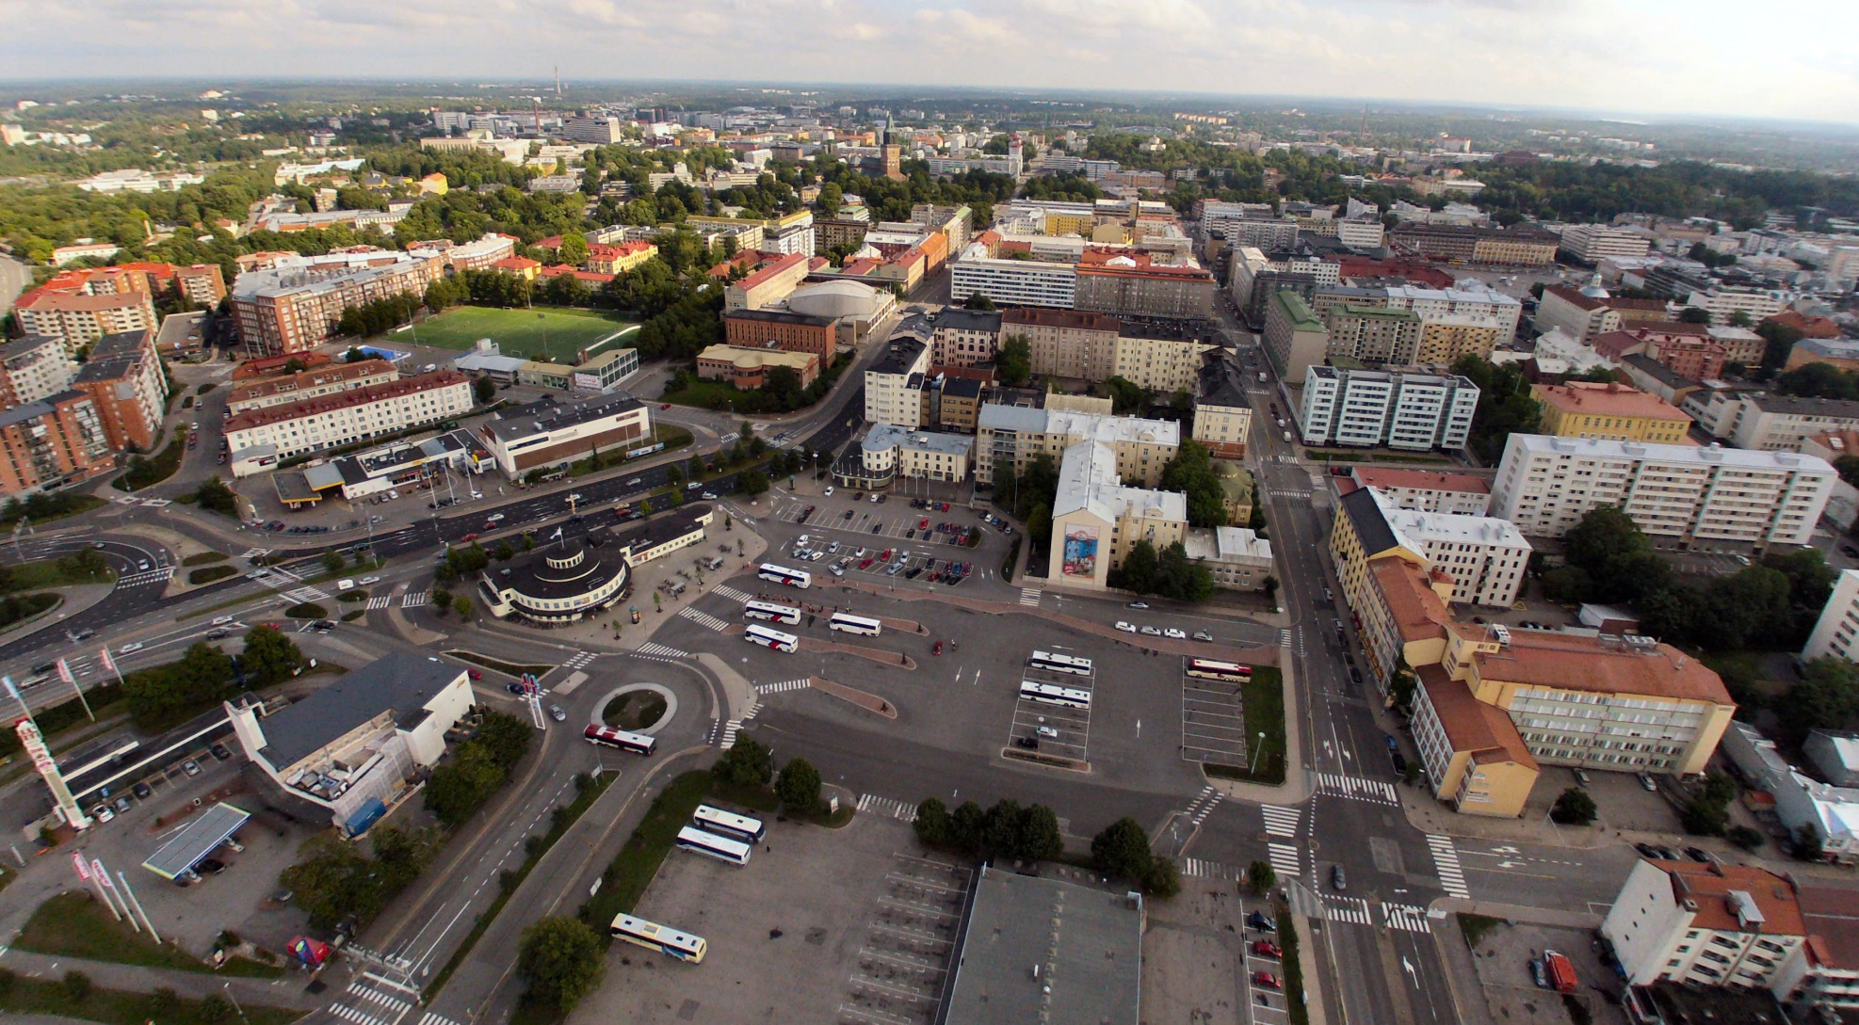
The city of Turku

Slide 4
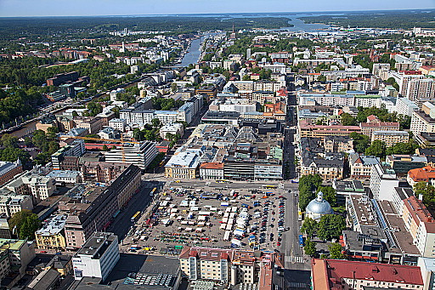
The city of Turku

Slide 5
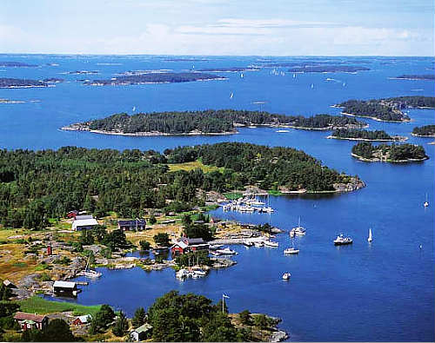
Baltic see and islands around Turku

Slide 6
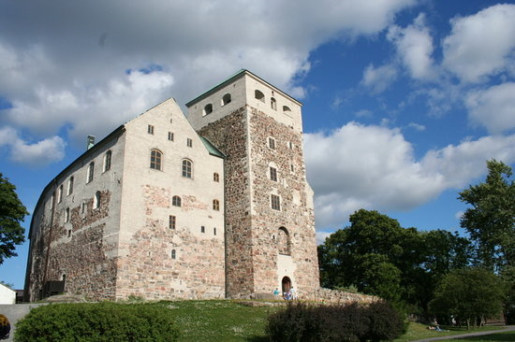
Turku castle

Slide 7
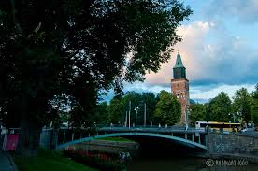
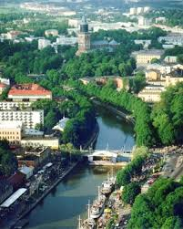
Living in Turku
Turku, a city of 180,000 inhabitants, is a lively town with an international atmosphere. Whether you are interested in culture or sports, strolling in the city or wandering in nature, you can find it all in Turku.
Although one of the biggest cities
in Finland, Turku is still small enough that you
can go almost everywhere by foot or bike.
As home to nearly 40,000 students, Turku provides endless possibilities for studying and leisure time. In a student city you are never alone!

Slide 8

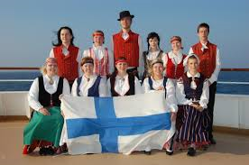
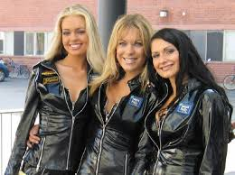
Finnish people
Finnish people in general are
down-to-earth, friendly and easy to get along with.
They appreciate the basic values of life; honesty, modesty and friendship have traditionally been highly appreciated.
Many Finns enjoy an active lifestyle; nature and environment are important to them.
Ninety per cent of Finns speak Finnish as their mother tongue. There is also a Swedish-speaking minority in Finland, and Swedish is the country’s other official language.
Most Finns speak English quite well so you should
get by in shops, banks, etc., speaking English.

Slide 9
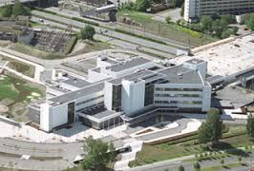
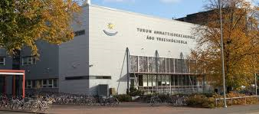
University of Applied Sciences in Turku and exchange period
University of Applied Sciences in Turku is one the leading universities of applied sciences in Finland, and home to over 9,500 Finnish and international students.
An exchange period is not just about studying, but also about making friends and exploring different cultures.
There is always a lot going on for students both in Turku and Salo. You can join the ESN-IAC events aimed at exchange students or take part in the activities organized by the Student union TUO.

Slide 10

Student Union TUO
The student union of the Turku University of Applied Sciences - the organization that takes care of your interests as a student.
TUO has altogether over 4500 members.
The membership of the student union is optional.
TUO offers numerous membership benefits you can also get student discount from train (45-55 %) and bus tickets (50 %). Many shops, theaters, gyms etc. all around Finland have student discounts.

Slide 11
International week on the Ruiskatu campus in Turku
24 guests from Europe, China and the United States shared experiences on education and projects in the field of health and social care issues. What activities we did?
Several expert lectures in the field of social and health care was given during the week.
Experiences on student exchange, international projects and practical training were discussed.
We created friendly international athmosphere
There was a networking event organised on a cruise to Åland. The international guests and the teachers and Master’s degree programmes students participated in the cruise. The beautiful Turku archipelago was inspirational for further work and new ideas.

Slide 12
Let´s talk about exchange studies and practical training at Turku University of Applied Sciences.
University of Applied Sciences in Turku is one the leading universities of applied sciences in Finland, and home to over 9,500 Finnish and international students.
Exchange studies are professionally oriented, and include a lot of project and group work.
You can choose from a wide selection of courses taught in English.
You have a Finnish student tutor to assist you during your exchange studies.
The student tutor will meet you on arrival, help you to take care of the practicalities at the beginning of your stay and introduce you to TUAS.

Slide 13
Arrival to Turku
From Turku airport there are regular buses (€ 3,00) to the city center. There are also taxis waiting outside the terminal (airport - city centre € 20–25). If the flight is on time, you shouldn’t have any problems getting to the city centre (by bus or taxi) rather quickly, as Turku is not a very big city.
If your flight arrives in Helsinki-Vantaa Airport, there are also frequent bus connections going every hour to Turku from Helsinki-Vantaa airport. The long-distance bus from the international terminal leaves from Platform 14, just in front of the terminal.
Timetables can be found easily (Place of departure: Helsinki-Vantaa International Terminal, Destination: Turku).

Slide 14
Instructions for finding the Ruiskatu campus:
You can check the local bus timetables and maps at www.reittiopas.turku.fi
From the market place the buses no. 18 (towards Harittu) and 61 (towards Ilpoinen) (click the links to see the maps)
The bus ride costs 3,00€ (right to transfer within two hours)
24 h travel ticket 6,50€ (can be bought at the bus),
check other options (Tourist Card that is valid for 1-7 days) from here.
The Tourist card can be bought:
at the Local Traffic Service Office (Aurakatu 5, Mon–Fri 08:00–18:00, Sat 09:00–14:00)
at the department stores Stockmann (Yliopistonkatu 22, Mon–Fri 09:00–21:00, Sat 09:00–18:00, Sun 12:00–18:00) and Sokos Wiklund (Eerikinkatu 11, Mon–Fri 08:00–21:00, Sat 09:00–18:00, Sun 12:00–18:00)
at Turku Touring tourist information (Aurakatu 4, Mon-Fri 08.30–18.00, Sat-Sun 10.00–15.00 Mon – Fri 10:00–15:00).
o The card can’t be bought at the buses.

Slide 15

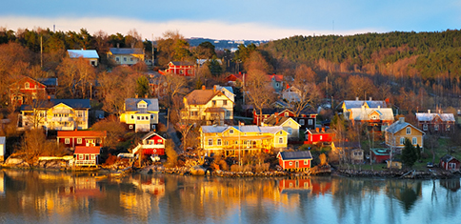

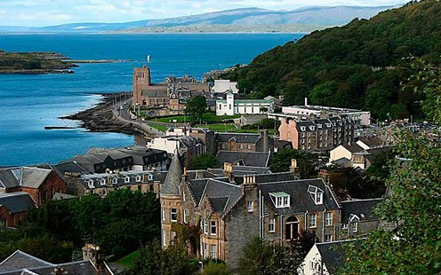
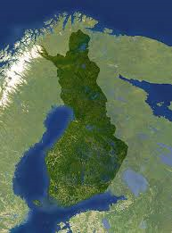

Visit Finland
http://www.visitfinland.com/

Slide 16
Contact person at TUAS
For more information about the international activities you can contact:
Hanna Peussa, International Relations Coordinator: tel. + 358 40 3550 421

Slide 17

That´s the end ☺
Thank you for your attention!

